Slide 1
Structure Programming
ICT-1105
Information and Communication Technology
Lecture-11
Date:

Slide 2
Class contents has given in Google Classroom with code
nhauiw4

Slide 3
Iterative Statements

Slide 4
Iterative Statements/ Loop Control Statements
A sequence of statements are executed until a specified condition is true. This sequence of statements to be executed is kept inside the curly braces { } known as the Loop body. After every execution of loop body, condition is verified, and if it is found to be true the loop body is executed again. When the condition check returns false, the loop body is not executed.

Slide 5
Iterative Statements/ Loop Control Statements
The loops in C language are used to execute a block of code or a part of the program several times. In other words, it iterates/repeat a code or group of code many times.
Or Looping means a group of statements are executed repeatedly, until some logical condition is satisfied.

Slide 6
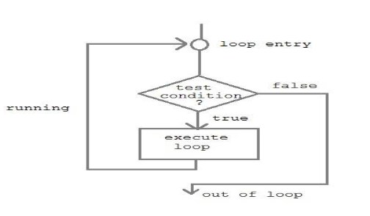
Iterative Statements/ Loop Control Statements

Slide 7
Why use loops in C language?
Suppose that you have to print table of 2, then you need to write 10 lines of code. By using the loop statement, you can do it by 2 or 3 lines of code only.

Slide 8
Iterative Statements/ Loop Control Statements
A looping process would include the following four steps.
Initialization of a condition variable.
Test the condition.
Executing the body of the loop depending on the condition.
Updating the condition variable.

Slide 9
Iterative Statements/ Loop Control Statements
C language provides three iterative/repetitive loops.
1 : while loop
2 : do-while loop
3 : for loop

Slide 10
while statements
The while statement is used when the program needs to perform repetitive tasks. The general form of a while statement is:
while ( condition)
statement ;

Slide 11
while statements
While Loop: Syntax :
variable initialization ;
while (condition)
{
statements ;
variable increment or decrement ;
}

Slide 12
while statements
while loop can be addressed as an entry control loop. It is completed in 3 steps.
Variable initialization.( e.g int x=0; )
condition( e.g while( x<=10) )
Variable increment or decrement ( x++ or x-- or x=x+2 )

Slide 13
while statements
The while loop is an entry controlled loop statement, i.e means the condition is evaluated first and if it is true, then the body of the loop is executed.
After executing the body of the loop, the condition is once again evaluated and if it is true, the body is executed once again, the process of repeated execution of the loop continues until the condition finally becomes false and the control is transferred out of the loop.

Slide 14
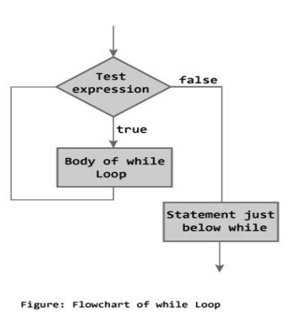
while statements
Flowchart

Slide 15
while statements
Example : Program to print first 10 natural numbers
#include<stdio.h>
int main( )
{
int x;
x=1;

Slide 16
while statements
while(x<=10)
{
printf("%d\t", x);
x++;
}
return 0;
}
Output
1 2 3 4 5 6 7 8 9 10

Slide 17
while statements
C Program to reverse number
#include<stdio.h>
#include<conio.h>
main()
{
int n, reverse=0, rem;
clrscr();
printf("Enter a number: ");
scanf("%d", &n);

Slide 18
while statements
while(n!=0)
{
rem=n%10;
reverse=reverse*10+rem;
n/=10;
}
printf("Reversed Number: %d",reverse);
getch();
}

Slide 19
while statements
/* This program checks whether a given number is a palindrome or not */
#include <stdio.h>
int main()
{
int n, reverse = 0, temp;
printf("Enter a number to check if it is a palindrome or not\n");
scanf("%d",&n);
temp = n;

Slide 20
while statements
while( temp != 0 )
{
reverse = reverse * 10;
reverse = reverse +temp%10;
temp = temp/10;
}
if ( n == reverse )
printf("%d is a palindrome number.\n", n);
else
printf("%d is not a palindrome number.\n", n);
return 0;
}

Slide 21
while statements
Output:
Enter a number to check if it is a palindrome or not
12321
12321 is a palindrome
Enter a number to check if it is a palindrome or not
12000
12000 is not a palindrome

Slide 22
do-while loop
The body of the do-while executes at least once. The do-while structure is similar to the while loop except the relational test occurs at the bottom (rather than top) of the loop. This ensures that the body of the loop executes at least once. The do-while tests for a positive relational test; that is, as long as the test is True, the body of the loop continues to execute.

Slide 23
do-while loop
Syntax :
variable initialization ;
do
{
statements ;
variable increment or decrement ;
}while (condition);

Slide 24
do-while loop
The do-while loop is an exit controlled loop statement. The body of the loop are executed first and then the condition is evaluated. If it is true, then the body of the loop is executed once again. The process of execution of body of the loop is continued until the condition finally becomes false and the control is transferred to the statement immediately after the loop. The statements are always executed at least once.

Slide 25
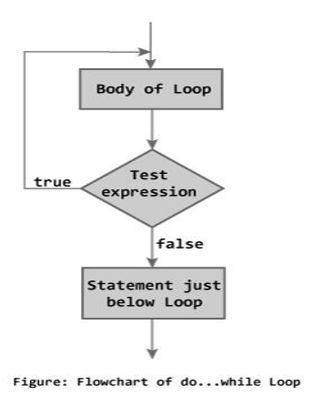
do-while loop
Flowchart

Slide 26
do-while loop
Example : Program to print first ten multiple of 5
#include<stdio.h>
#include<conio.h>
void main()
{
int a,i;
a=5;
i=1;

Slide 27
do-while loop
do
{
printf("%d\t",a*i);
i++;
}while(i <= 10);
getch();
}
Output
5 10 15 20 25 30 35 40 45 50

Slide 28
do-while loop
do
{
printf("%d\t",a*i);
i++;
}while(i <= 10);
getch();
}
Output
5 10 15 20 25 30 35 40 45 50

Slide 29
do-while loop
// C program to add all the numbers entered by a user until user enters 0
#include <stdio.h>
int main()
{
int sum=0,num;
do /* Codes inside the body of do...while loops are at least executed once. */
{
printf("Enter a number\n");
scanf("%d",&num);
sum+=num;
} while(num!=0);
printf("sum=%d",sum);
return 0;
}

Slide 30
do-while loop
// C program to add all the numbers entered by a user until user enters 0
Output:
Enter a number
3
Enter a number
-2
Enter a number
0
sum=1

Slide 31
do-while loop
Consider the following program:
#include <stdio.h>
Int main()
{
int i = 10;
do
{
printf("Hello %d\n", i );
i = i -1;
}while ( i > 0 );
return 0;
}

Slide 32
do-while loop
Output:
Hello 10
Hello 9
Hello 8
Hello 7
Hello 6
Hello 5
Hello 4
Hello 3
Hello 2
Hello 1

Slide 33
do-while loop
*Program to count the no of digits in a number
#include <stdio.h>
int main()
{
int n,count=0;
printf("Enter an integer: ");
scanf("%d", &n);

Slide 34
do-while loop
do
{
n/=10; /* n=n/10 */
count++;
} while(n!=0);
printf("Number of digits: %d",count);
}

Slide 35
do-while loop
Output
Enter an integer: 34523
Number of digits: 5

Slide 36
for loop
This is an entry controlled looping statement.
In this loop structure, more than one variable can be initialized.
One of the most important features of this loop is that the three actions can be taken at a time like variable initialization, condition checking and increment/decrement.
The for loop can be more concise and flexible than that of while and do-while loops.

Slide 37
for loop
Syntax :
for( initialization; condition; increment/decrement)
{
Statements;
}

Slide 38
for loop
Example:
#include<stdio.h>
#include<conio.h>
void main( )
{
int x;
for(x=1; x<=10; x++)
{
printf("%d\t",x);
}
getch();
}
Output
1 2 3 4 5 6 7 8 9 10

Slide 39
for loop
Consider the following program
int main(void)
{
int num;
printf(" n n cubed\n");
for (num = 1; num <= 6; num++)
printf("%5d %5d\n", num, num*num*num);
return 0;
}

Slide 40
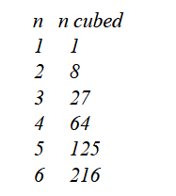
for loop
The program prints the integers 1 through 6 and their cubes

Slide 41
for loop
The program prints the integers 1 through 6 and their cubes

Slide 42
for loop
Program to print the sum of 1st N natural numbers.
#include <stdio.h>
int main()
{
int n,i,sum=0;
printf("Enter the limit: ");
scanf("%d", &n);
for(i=1;i<=n;i++)
{
sum = sum +i;
}
printf("Sum of N natural numbers is: %d",sum);
}

Slide 43
for loop
Output
Enter the limit: 5
Sum of N natural numbers is 15.

Slide 44
for loop
Program to find the reverse of a number
#include<stdio.h>
int main()
{
int num,r,reverse=0;
printf("Enter any number: ");
scanf("%d",&num);
for(;num!=0;num=num/10)
{
r=num%10;
reverse=reverse*10+r;
}
printf("Reversed of number: %d",reverse);
return 0;
}

Slide 45
for loop
Output:
Enter any number: 123
Reversed of number: 321

Slide 46
for loop
Various forms of FOR LOOP
I am using variable num in all the below examples –
1) Here instead of num++, I’m using num=num+1 which is nothing but same as num++.
for (num=10; num<20; num=num+1)

Slide 47
for loop
2) Initialization part can be skipped from loop as shown below, the counter variable is declared before the loop itself.
int num=10;
for (; num<20; num++)
Must Note: Although we can skip init part but semicolon (;) before condition is must, without which you will get compilation error.

Slide 48
for loop
3) Like initialization, you can also skip the increment part as we did below. In this case semicolon (;) is must, after condition logic. The increment part is being done in for loop body itself.
for (num=10; num<20; )
{
//Code
num++;
}

Slide 49
for loop
4) Below case is also possible, increment in body and init during declaration of counter variable.
int num=10;
for (;num<20;)
{
//Statements
num++;
}

Slide 50
for loop
5) Counter can be decremented also, In the below example the variable gets decremented each time the loop runs until the condition num>10 becomes false.
for(num=20; num>10; num--)

Slide 51
for loop
Factorial Program using loop
#include<stdio.h>
#include<conio.h>
void main()
{
int i,fact=1,number;
clrscr();
printf("Enter a number: ");
scanf("%d",&number);
for(i=1;i<=number;i++)
{
fact=fact*i;
}
printf("Factorial of %d is: %d",number,fact);
getch();
}

Slide 52
for loop
Output:
Enter a number: 5
Factorial of 5 is: 120

Slide 53
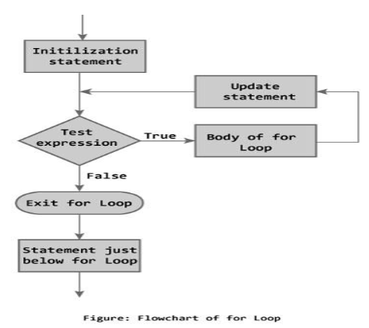
for loop
Flow Chart of for Loop :

Slide 54
for loop
Infinitive for loop in C
If you don't initialize any variable, check condition and increment or decrement variable in for loop, it is known as infinitive for loop. In other words, if you place 2 semicolons in for loop, it is known as infinitive for loop.
for(; ;)

Slide 55
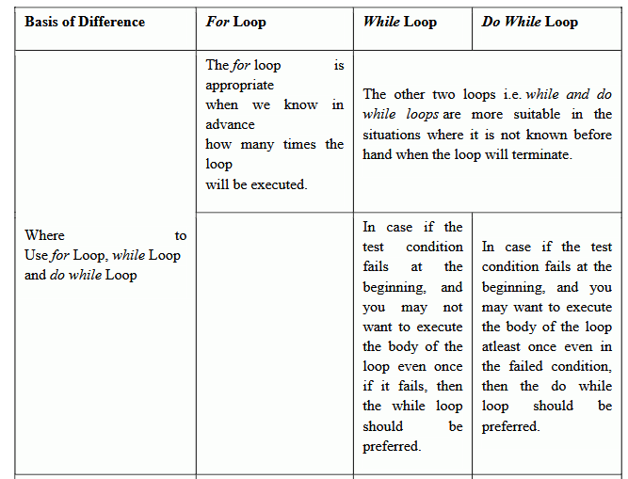

Slide 56
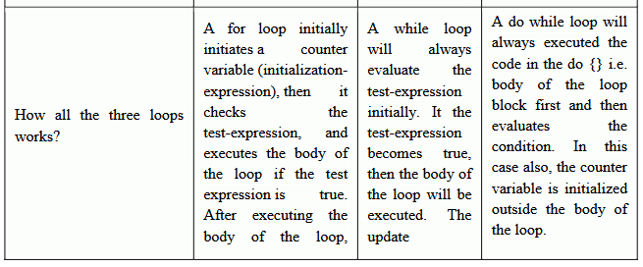

Slide 57
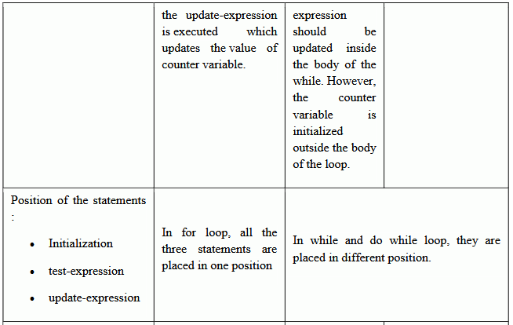

Slide 58
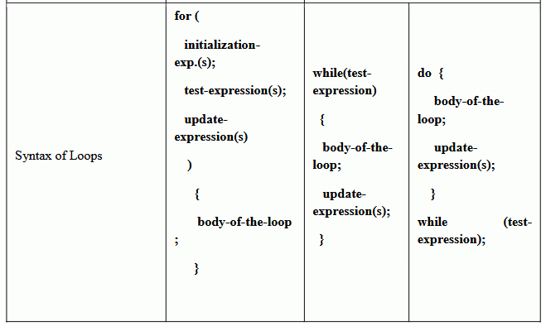

Slide 59
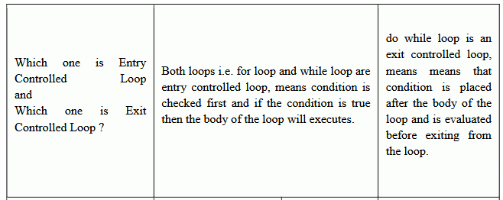

Slide 60
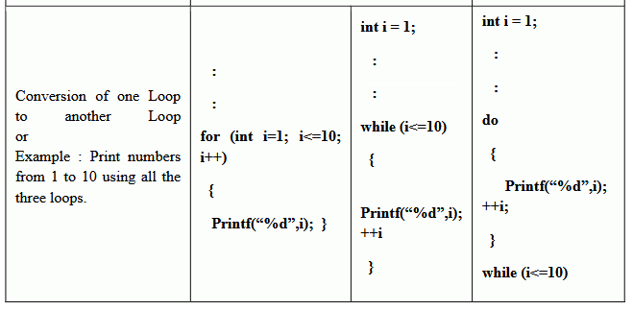

Slide 61
Nested for loop
We can also have nested for loops, i.e one for loop inside another for loop. nesting is often used for handling multidimensional arrays.

Slide 62
Nested for loop
Syntax:
for(initialization; condition; increment/decrement)
{
for(initialization; condition; increment/decrement)
{
statement ;
}
}

Slide 63
Nested for loop
Example:
main()
{
for (int i=0; i<=5; i++)
{
for (int j=0; j<=5; j++)
{
printf("%d, %d",i ,j);
}
}
}

Slide 64
Nested for loop
Example : Program to print half Pyramid of numbers
#include<stdio.h>
#include<conio.h>
void main( )
{
int i,j;
for(i=1;i<5;i++)
{
printf("\n");

Slide 65
Nested for loop
for(j=i;j>0;j--)
{
printf("%d",j);
}
}
getch();
}

Slide 66

Nested for loop
#include<stdio.h>
#include<conio.h>
void main( )
{
int i,j;
for(i=1;i<5;i++)
{
printf("\n");
for(j=i;j>0;j--)
{
printf("%d",j);
}
}
getch();
}

Slide 67
Nested loop
The syntax for a nested while loop statement in C programming language is as follows:
while(condition)
{
while(condition)
{
statement(s);
}
statement(s);
}

Slide 68
Nested loop
The syntax for a nested do...while loop statement in C programming language is as follows:
do
{
statement(s);
do
{
statement(s);
}while( condition );
}while( condition );

Slide 69
Nested loop
A final note on loop nesting is that you can put any type of loop inside of any other type of loop.
For example, a for loop can be inside a while loop or vice versa.

Slide 70
Nested loop
Programs: using a nested for loop to find the prime numbers from 2 to 20:
#include <stdio.h>
int main ()
{
/* local variable definition */
int i, j;
for(i=2; i<20; i++)
{
for(j=2; j <= (i/j); j++)
if(!(i%j))
break; // if factor found, not prime
if(j > (i/j))
printf("%d is prime\n", i);
}
return 0;
}

Slide 71
Nested loop
Output
2 is prime
3 is prime
5 is prime
7 is prime
11 is prime
13 is prime
17 is prime
19 is prime

Slide 72
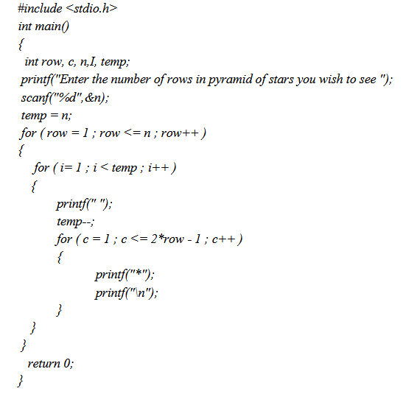

Nested loop

Slide 73
Thank you….

